Slide 1
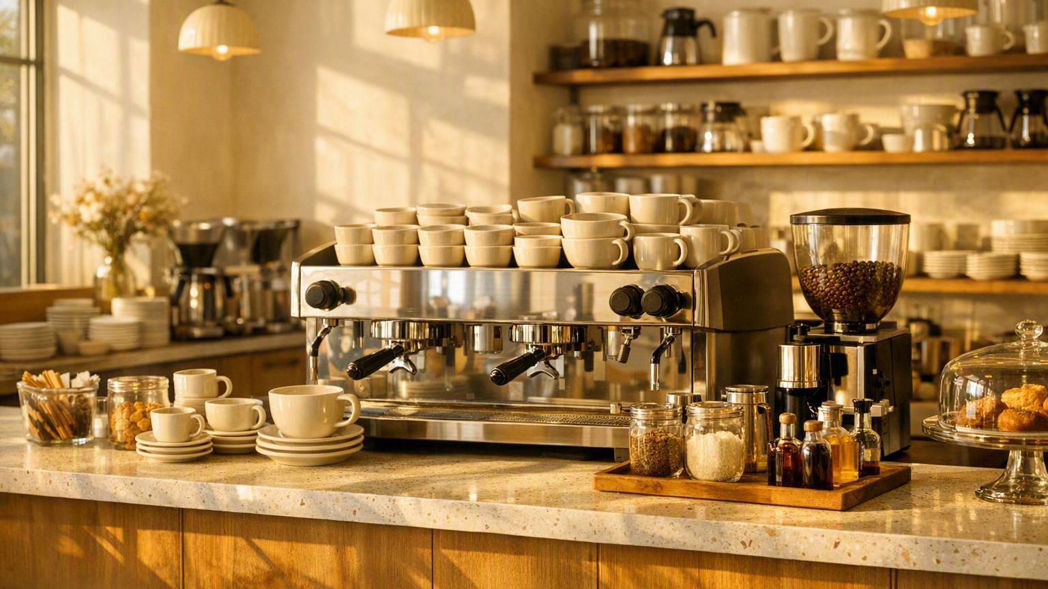
BRIGHT COFFEE SHOP
A simple plan for
better coffee shop decisions
Understand what sells, when customers visit and what to improve
01
PREPARED BY • HITEKANI MASINGI
Notes:
Source: Bright Coffee Shop Sales Analysis Plan (user-provided). Cover image: AI-generated editorial café scene.

Slide 2
YOUR GUIDE
A short, practical journey through the sales data
01
Ask useful questions
Products, busy times, basket size and sales direction
03
02
Build trustworthy data
The fields to collect and the checks to run
04–05
03
Measure what matters
A simple workflow and six starting measures
06–07
04
Turn insight into action
Small tests for stock, staffing and promotions
08
Then we finish with questions and a thank you.
BRIGHT COFFEE SHOP • SALES ANALYSIS PLAN
02

Slide 3
START HERE
Four everyday questions keep the analysis useful
01
What do customers buy?
Product revenue, category mix and slow sellers
STOCK THE RIGHT RANGE
02
When is the shop busiest?
Sales by hour, day and month
PLAN STAFF AND STOCK
03
How big is a typical purchase?
Items and value per transaction
IMPROVE BUNDLES AND UPSELLING
04
Are sales moving in the right direction?
Revenue and transactions over time
TRACK PROGRESS AND INVESTIGATE CHANGES
Important: sales data shows contribution, not profit. Add product cost before making profitability claims.
BRIGHT COFFEE SHOP • SALES ANALYSIS PLAN
03
Notes:
Source: Bright Coffee Shop Sales Analysis Plan (user-provided).

Slide 4
DATA FOUNDATION
A useful sales row needs the basics—and two helpful extras
WHEN
WHAT SOLD
VALUE
Transaction ID Date Time
Product Category Quantity
Unit price Total sales
Lets us count visits and find busy periods.
Shows demand by item and product group.
Supports revenue and basket-value measures.
Helpful extras
Payment method and store location add context. Product cost is the key extra needed for profit analysis.
CALCULATION CHECK • Total sales should equal Quantity × Unit price
BRIGHT COFFEE SHOP • SALES ANALYSIS PLAN
04
Notes:
Source: Bright Coffee Shop Sales Analysis Plan (user-provided).

Slide 5
BEFORE ANALYSIS
Clean the data before asking it questions
1
Remove repeats
One transaction should not appear twice.
2
Deal with blanks
Decide whether to fix, exclude or label missing values.
3
Use one name
“Latte” and “Caffè Latte” should not split the same product.
4
Fix dates and times
Use true date/time fields so hours, days and months sort correctly.
5
Create useful fields
Add day, month, hour, time of day and checked total revenue.
Three quick trust checks
No duplicate transaction IDs
Quantity and price are positive
Dates match the expected trading period
BRIGHT COFFEE SHOP • SALES ANALYSIS PLAN
05
Notes:
Source: Bright Coffee Shop Sales Analysis Plan (user-provided).

Slide 6
KEEP IT PRACTICAL
Prepare → explore → explain
01
→
02
→
03
PREPARE
EXPLORE
EXPLAIN
Databricks + SQL
Power BI • Excel • Looker Studio
PowerPoint • Lovable
Build one clean transaction table.
Compare products, periods and baskets.
Share what changed, why it matters and what to test.
Output: trusted data
Output: clear patterns
Output: decisions
ONE SOURCE OF TRUTH • Use the same cleaned table in every tool.
BRIGHT COFFEE SHOP • SALES ANALYSIS PLAN
06
Notes:
Source: Bright Coffee Shop Sales Analysis Plan (user-provided).

Slide 7
FIRST DASHBOARD
Six measures give a strong first view
01
Total revenue
04
Average transaction value
Sum of Total sales
Revenue ÷ Transactions
Overall sales value
Typical spend per purchase
02
Transactions
05
Items per transaction
Count of unique Transaction IDs
Units sold ÷ Transactions
How many purchases happened
Typical basket size
03
Units sold
06
Category mix
Sum of Quantity
Category revenue ÷ Total revenue
How many items were bought
Where sales are concentrated
Slice these measures by product, category, hour, day and month.
Profit still needs cost data.
BRIGHT COFFEE SHOP • SALES ANALYSIS PLAN
07
Notes:
Source: Bright Coffee Shop Sales Analysis Plan (user-provided).

Slide 8
FROM INSIGHT TO ACTION
Turn patterns into small, testable changes
IF THE DATA SHOWS…
TRY THIS
THEN CHECK
01
A clear morning or lunch peak
Move staff and stock into that window
Wait time, stock-outs and sales
02
A strong product with frequent add-ons
Create a simple bundle
Basket value and bundle take-up
03
A slow period that repeats each week
Test one time-limited offer
Transactions and discount cost
04
An item stays weak across several periods
Change placement, price or range
Units, waste and customer response
Good practice: change one thing at a time, agree a time window, and compare before versus after.
No decision should rely on one unusual day.
BRIGHT COFFEE SHOP • SALES ANALYSIS PLAN
08
Notes:
Source: Bright Coffee Shop Sales Analysis Plan (user-provided). Recommendations are intentionally conditional because no dataset or measured results were supplied.

Slide 9
BRIGHT COFFEE SHOP
Questions? Let’s talk.
What would you like to explore, challenge or add?
Thank you
HITEKANI MASINGI
09

